Slide 1
PROBLEM SOLVING
LEAD Development Workshop
Notes:
Materials Needed
Participant Workbooks
Flipchart and Markers
Tape for hanging pictures
Length of Training
2 Hours
Learning Objectives
Identify the five steps to problem solving.
Discuss the steps to effective Problem Solving using real life examples.
Identify and practice solutions to problem solving based on real life scenarios and classroom scenarios.
Who Should Participate
Assistant Managers
General Managers
Exercises
There will be various interactive group exercises through out the module
Opening Script
Introductions/Session opener pertaining to Problem Solving
Discuss the Action Plan at the back of the material
Review logistics (i.e. cell phones on vibrate, breaks, etc.)
Review learning objectives

Slide 2
Disclaimer
Please note: This module contains an example of a recently updated employment related tool used by Arby’s Restaurant Group, Inc. (“ARG”) in the operation of its company-owned restaurants. We are providing this information only for informational purposes to be used as a tool to assist you with your business. You are not required to use this information. These tools are specifically geared for ARG’s business needs, and your needs and business and legal requirements may vary. ARG does not guarantee that your use of this information will alter your results, economically or otherwise.
By receiving this information, you confirm that you are an independent contractor, and we are not your partner, joint venture or joint employer, nor are you our employee. Additional tools that may work for your organization are available through a variety of sources including consultants, periodicals and books, and software. In addition, small business owners should have their company’s hiring practices and assessment processes, including training of manager and employees, reviewed by a qualified attorney and/or consultant. It is your responsibility to ensure that some or all action items described in this document are permitted under your applicable state law.
4-2016
Notes:
Please note: This module contains an example of a recently updated employment related tool used by Arby’s Restaurant Group, Inc. (“ARG”) in the operation of its company-owned restaurants. We are providing this information only for informational purposes to be used as a tool to assist you with your business. You are not required to use this information. These tools are specifically geared for ARG’s business needs, and your needs and business and legal requirements may vary. ARG does not guarantee that your use of this information will alter your results, economically or otherwise.
By receiving this information, you confirm that you are an independent contractor, and we are not your partner, joint venture or joint employer, nor are you our employee. Additional tools that may work for your organization are available through a variety of sources including consultants, periodicals and books, and software. In addition, small business owners should have their company’s hiring practices and assessment processes, including training of manager and employees, reviewed by a qualified attorney and/or consultant. It is your responsibility to ensure that some or all action items described in this document are permitted under your applicable state law.
4-2016

Slide 3
LEAD Curriculum Components
L
E
A
D
A Management Development Program
EXPERIENCE
ASSESS
LEARN
DEVELOP
Notes:
LEAD Curriculum
This course is a part of the LEAD curriculum. Curriculum includes:
Learn – LEAD modules, training programs
Experience – Experience toolkit
Assess – Next level assessments
Develop – Development review process

Slide 4

Icebreaker – Envelope Exercise
Notes:
Envelope Exercise Icebreaker – 5 minutes
Leader Instructions:
Have participants turn to the exercise in their workbook.
Tell the class:
Here are the rules:
Draw the following diagram.
Do not take the pen or pencil off of the paper.
Do not cross over any line.
Do not go over the same line twice.
When you have solved the problem, raise your hand.
TRAINER NOTE
If no group has solved the problem within 5 minutes, share the answer on the next slide. Discuss the exercise with the group.

Slide 5










Icebreaker – Envelope Exercise Answer
10
Notes:
Envelope Exercise Icebreaker – Answer
This exercise shows that sometimes it is necessary to think outside of the box when trying to solve a difficult problem.
“Being successful doesn’t mean that you don’t have problems; it means that you know how to solve them.”

Slide 6
Five Steps to Problem Solving
Identify a problem that you are working to resolve in your restaurant. We will use that issue to work through the five step problem solving process.
Identify
1
Determine Root Causes
Measure Results
5
2
4
3
Brainstorm Ideas
Execute
Notes:
Five Steps to Problem Solving
Unfortunately, we all have come across problems in our workplace at one time or another. The problems can be large or small, easy or difficult, but no matter what the problems are, an important skill every employee needs is the ability to solve them.
Today we are going to discuss the process of problem solving. From identifying the problem to measuring the solution, we are going to dig deep into the steps to solving a problem.
Here are the 5 steps for Problem Solving:
Identify
Determine Root Causes
Brainstorm Ideas
Execute
Measure Results
I’d like you each to take a moment and identify a problem that you are working to resolve in your work place. Throughout this workshop, as we work through the process of problem solving, we will be using your examples. We will be discussing the Five Steps in the problem solving process.
TRAINER NOTE
Have the class identify a problem that they are currently working on and write it on the bottom of page 1.

Slide 7
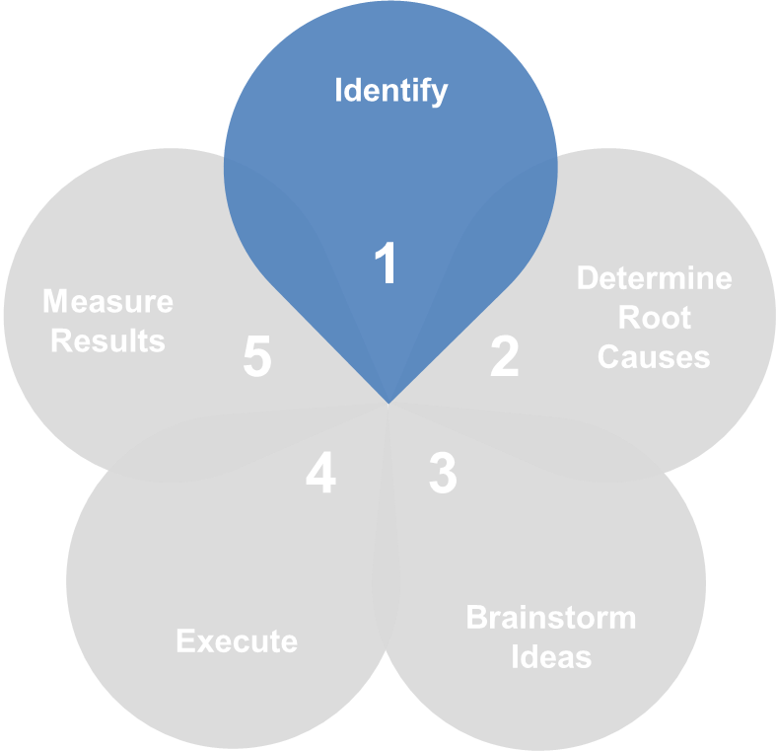
Problem Solving Step 1: Identify
Set Standards and Identify the Tolerance Level
Awareness
Clearly Define the Problem
Simplify
Notes:
Five Steps to Problem Solving – Step 1: Identify
TRAINER NOTE
Each step will have a quote from a notable person. Ask a different volunteer to read the quote aloud.
“The problem is not that there are problems. The problem is expecting otherwise and thinking that having problems is a problem.”
-Theodore Rubin
Let’s start at the beginning. How do you know when you have a problem? In order to know you have a problem, you have to have predetermined standards:
TRAINER NOTE
Instruct participants to write the standards in their book in the corresponding blanks.
Set Standards and Identify the Tolerance Level
Know what it looks and feels like when things are going well. Also, what is the acceptable measure of variation from the standards?
For example, a goal for cash +/- is zero, but we agree that a tolerance of 10 cents +/- per $100 is an acceptable standard. So, when those standards are not being met – and the variation to standard is greater than the agreed upon tolerance, there is a problem. The identifiers that you use for determining if there is a problem are not always numerical. They could be visual signs, sounds, actions and behaviors, or even smells. We know when our products are prepared correctly. When the color is too dark or too light, we have a problem.
Awareness
The key to identifying problems is to be aware. Know what is happening around you and don’t procrastinate if something is falling below expected standards. Most problems don’t start out at the crisis stage; they start out small and grow in size and urgency when they are not addressed at an early stage. Think about what happens when you don’t identify a problem until it is critical. You are no longer able to work on solving the problem; you are too busy dealing with the impact of the problem. For example, when your boat has a small leak, you can fix the leak, but when your boat has a huge hole and is taking on water at a rapid rate, you must concentrate on bailing out the water, not on fixing the leak. “A problem well stated is a problem half solved.”
Clearly Define the Problem
Part of the identification of a problem is to clearly define the problem. It is important to use your standards to clearly describe why you have a problem.
Simplify
State the problem in one sentence and be specific. The more people who understand the problem, the more resources you will have for solving the problem.
For example:
The Turnover of our closing team members is 180% versus a turnover rate of 100% for the rest of the team.

Slide 8
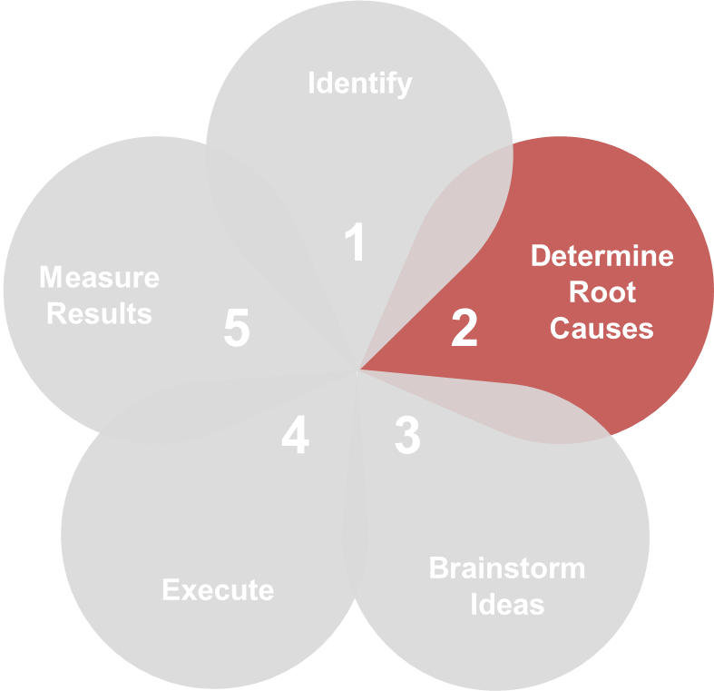
Problem Solving Step 2: Determine
Root Causes
Cause vs. Symptom
It’s About the Right Data
Long Term vs. Short Term
Notes:
Five Steps to Problem Solving – Step 2: Determine Root Causes
“Problems are only opportunities in work clothes.”
– Henry Kaiser
Cause vs. Symptom
This is perhaps the most critical step to solving a problem. You must know the difference between a cause and a symptom.
If I have a cold and treat my cough with cough syrup, have I solved the problem? No, I’ve only treated the symptom and the cough/cold will come back.
If you were looking for the root cause, you would need to determine how you caught the cold in the first place. If you caught the cold by going outside with wet hair in the winter, you would need to stop doing that, or you will continue to catch a cold.
This step is critical - if you take care of the symptom and not the root cause, the problem will just keep coming back.
It’s About the Right Data
Let’s look at another example – You walk into a restaurant during the dinner hour. The dining room is a mess, service is slow and you don’t see a manager. When you ask to see the manager, the team member tells you that they had to run to another restaurant because they were out of cups. When the manager gets back with the cups, they say, “Problem solved”.
TRAINER NOTE
Lead a discussion on the possible root cause of this problem and why it is so important to solve the problem at the root cause, versus the symptom (ran out of cups over dinner). Possible root causes might be: inaccurate projections, poor ordering, not using pre-rush checklist, the storeroom is unorganized and therefore we don’t have any idea what supplies we have.
It’s about getting the right data. Dig deep and keep peeling away the layers until you get down to the real issue.
Long Term Versus Short Term
Remember, your goal is to solve this problem for the long term, not the short term.
When you treat symptoms – the problems always come back!

Slide 9
Step 2: Determine Root Causes –
Exercise
Problem: Staffing
Each week there are several shifts that are left open on the schedule.
What are the potential root causes?
What information do we need to gather to determine the root cause?
Notes:
 Staffing Exercise (15 minutes)
TRAINER NOTE
Divide the class into groups of 2 - 3.
Read the following problem out loud to the class:
Our problem is staffing. Each week there are several shifts that are left open on the schedule.
Discuss what the potential root causes of this problem may be and what additional information you would need in order to determine the root cause.
Be prepared to share your answers with the class.
TRAINER NOTE
Have volunteers share their root causes and discuss as a whole group, potential answers are listed below. Write the answers provided on the Flip Chart.
Potential Root Causes:
Not enough applications
Poor interviewing skills
High turnover
Lack of training
No action on applications
Not enough applicants for the right time of the day (need nights and we get all day applications)
Information We Need to Gather to Determine the Root Cause:
Turnover
Number of applications received last 3 months
Number of hires in the last 3 months
Exit interviews
Analysis of training
Who is hiring and how is the quality of their hires
Any recruiting efforts

Slide 10
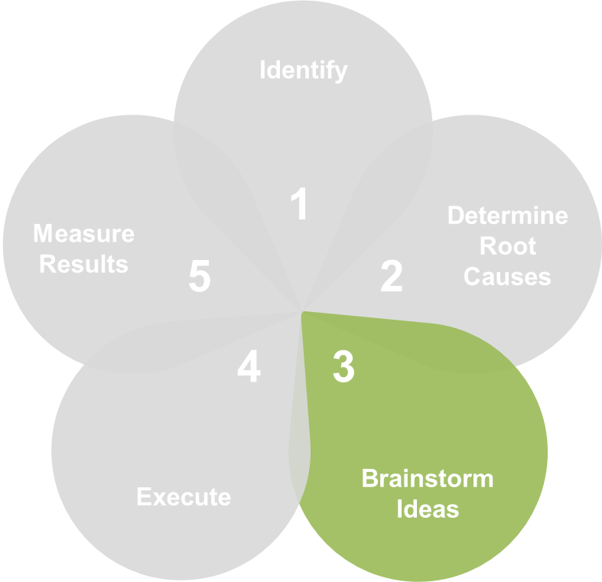

Problem Solving Step 3: Brainstorm
Ideas
No
Judgements
Piggyback on
Ideas
Don’t Set
Limits
Capture
All Ideas
Do Not
Discuss
Participate
Notes:
Five Steps to Problem Solving – Step 3: Brainstorming Ideas
Step Three: Brainstorm Solutions
“Nothing is more dangerous than an idea when it’s the only one you have.”
There have been several studies that show the most significant difference between creative and non-creative people is whether or not they believe they are creative. So, yes! You are creative! Everyone repeat after me, “I am creative!”
Now we are going to prove how creative we all are and how open our minds are to possibilities.
I’d like each of you to take 5 minutes and create a drawing on the last page of your workbook, using the lines that are already on the page as part of the picture. When you are finished, tear the page out of your book and bring it to me.
TRAINER NOTE
Give them 5 minutes to create their drawings, and as they finish tape the drawings up around the room. Point out the many possibilities that existed within those two lines and discuss how important it is to see possibilities and think outside the box.
Now that we’ve got those creative juices flowing, we’re going to do some brainstorming. But first, let’s talk about some guidelines:
No Judgments – During the brainstorming we don’t evaluate ideas, we just come up with them.
Piggyback on Ideas – Ideas create more ideas.
Don’t Set Limits - We will encourage outrageous thinking and put no boundaries on the ideas.
Capture All Ideas – Write down everything. It may spark additional ideas at a later point.
Do Not Discuss – Again, during the brainstorming session we don’t talk about the pros and cons of ideas.
Participate – Everyone should be involved in the brainstorming session.
 Staffing Exercise (10 minutes)
With additional “digging” we have determined that the root cause of our staffing problem is lack of applicant flow.
Within your small group, brainstorm as many solutions as you can to the staffing problem. Write down your brainstorming ideas and be prepared to share them with the class.
Be creative and think outside the box!
TRAINER NOTE
Have volunteers share their brainstorming and discuss as a whole group. Write the answers provided on the Flip Chart.

Slide 11
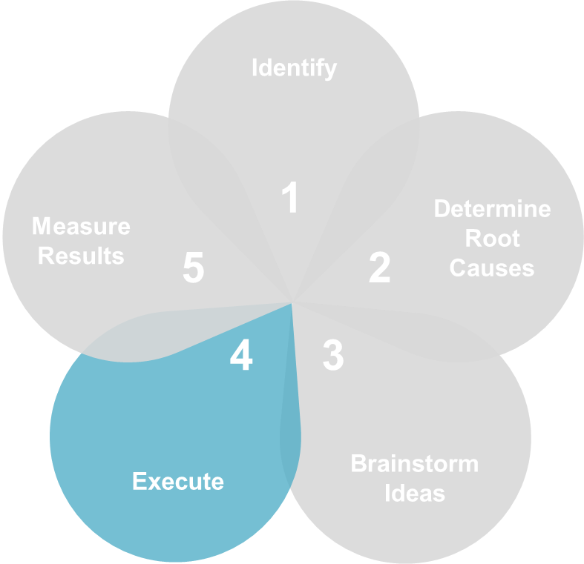

Problem Solving Step 4: Execute
Make a Plan and Stick to It!
Notes:
Five Steps to Problem Solving – Step 4: Execute
“There are no unsolvable problems, only time consuming ones.”
-James A. Michener
Once you have explored the possibilities, it is time to choose the solution that you feel is the best. Make a plan to execute that solution and stick to it.
Make a plan and stick to it!

Slide 12
Problem Solving Step 4: Execute
Set Timeframes
Determine Resources
Determine Responsibilities
Plan Communication
Measure Results
Notes:
Five Steps to Problem Solving – Step 4: Execute
When you develop a plan, it is important to be thorough. The plan needs to be implemented step by step.
Set Timeframes
Determine how long each task will take
Develop a schedule
Keep within the allotted time frame
Determine Resources
Determine material and/or equipment needed
Identify any training needs
Identify people needs
Determine Responsibilities
Who is responsible for each task?
What is the method of follow-up?
Plan Communication
Who needs to be involved?
Who needs to know?
What is the best way to communicate the plan?
Measure Results
How will I determine if the problem is solved?
Make a plan and stick to it!

Slide 13





Step 4: Execute – Brainstorming Exercise
Set
Timeframes
Determine
Resources
Determine
Responsibilities
Plan
Communication
Measure
Results
Notes:
Five Steps to Problem Solving – Step 4: Execute - Brainstorming Exercise (15 minutes)
Review your group’s brainstorming list, and create a plan for the most promising solution.
Set Timeframes
Determine Resources
Determine Responsibilities
Plan Communication
Measure Results
TRAINER NOTE
Have one or two groups volunteer to share their plans and discuss with the entire group.

Slide 14
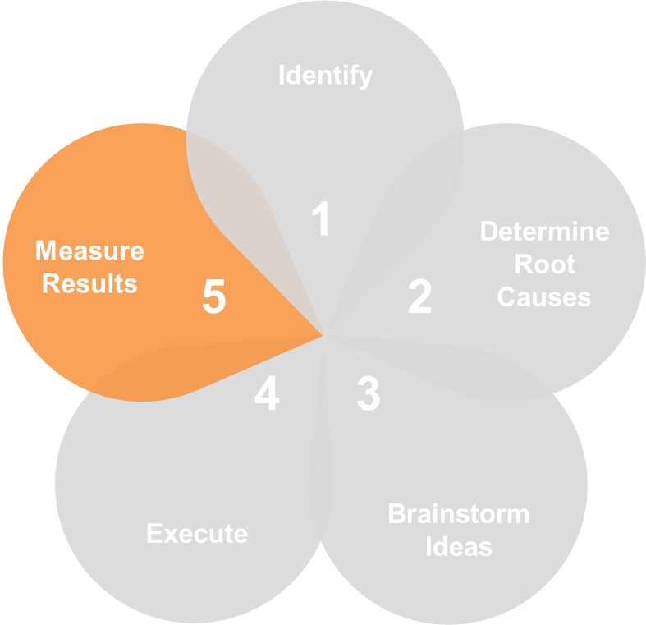

Problem Solving – Five Steps
Is the Problem Solved?
Follow-through on your plan
Objectively measure the results
Notes:
Five Steps to Problem Solving – Step 5: Measure Results
“Discipline can be the difference between success and failure.”
Is the Problem solved?
Have the discipline to follow-through on your plan and objectively measure the results.
Most importantly, have the courage to alter the plan if it isn’t working.
Problem solving is a process, not a one-time event. It is not about “knowing” the right answer. It’s about working your way through the many possibilities to the most effective and efficient solution.

Slide 15
Problem Solving Summary
Identify
1
Determine Root Causes
Measure Results
5
2
4
3
Brainstorm Ideas
Execute
Notes:
Problem Solving Summary
Today we learned that Problem solving is a process with steps that will lead to success.
TRAINER NOTE
Ask for volunteers or call on people to review each of the problem solving steps and what’s involved with each.
Identify
Set Standards and Identify the Tolerance Level
Awareness
Clearly Define the Problem
Simplify
Determine Root Causes
Cause vs. Symptom
It’s About the Right Data
Long Term Versus Short Term
Brainstorm Ideas
No Judgments
Piggyback on Ideas
Don’t Set Limits
Capture All Ideas
Do Not Discuss
Participate
Execute
Set Timeframes
Determine Resources
Determine Responsibilities
Plan Communication
Measure Results
Measure Results
Is the problem solved?
Follow-through on your plan
Objectively measure the results
Alter the plan if the outcome isn’t as desired
Remember to work the process when you come across a problem.
“Being successful doesn’t mean that you don’t have problems; It means that you know how to solve them.”

Slide 16
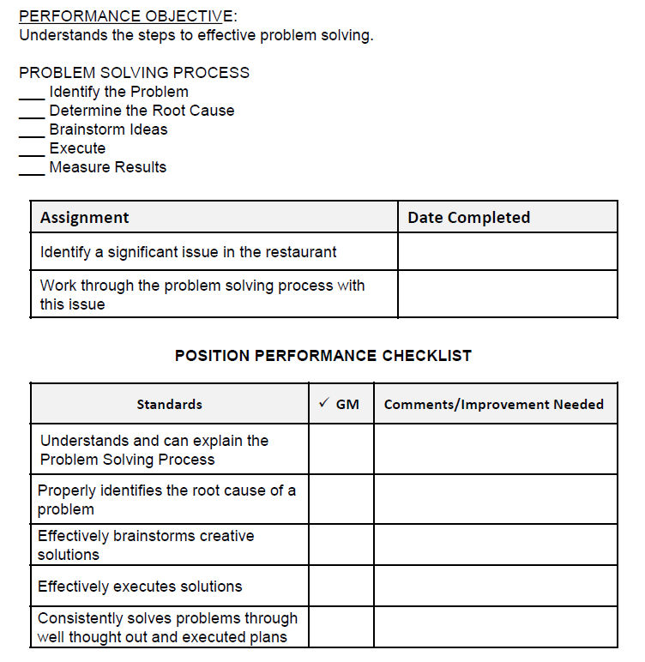
Homework
Notes:
Homework:
Let’s review the work you will do with your GM on putting the information you learned today into use. This chart is on the back page of your participant’s guide.

Slide 17
PROBLEM SOLVING

